Slide 1

Liftoff in Airline Safety: A Steady Descent in Fatal Flights
By: Jake Rickord

Slide 2
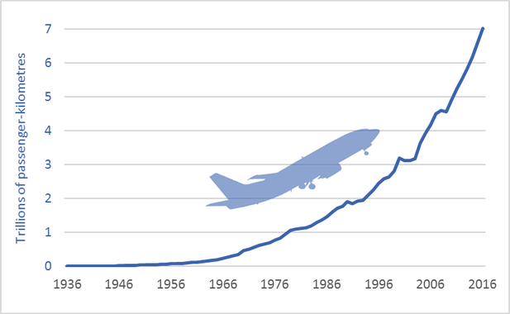
Industry Trends – Air Travel Popularity

Slide 3
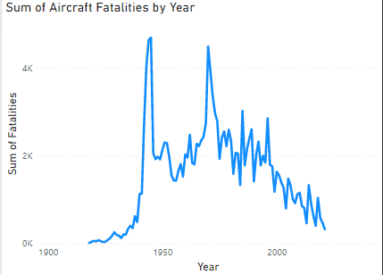
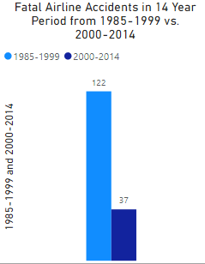
With More Passengers, What is Risk Trend?

Slide 4

HOW DOES THIS COMPARE TO The Rest of the TRANSPORT INDUSTRY?

Slide 5
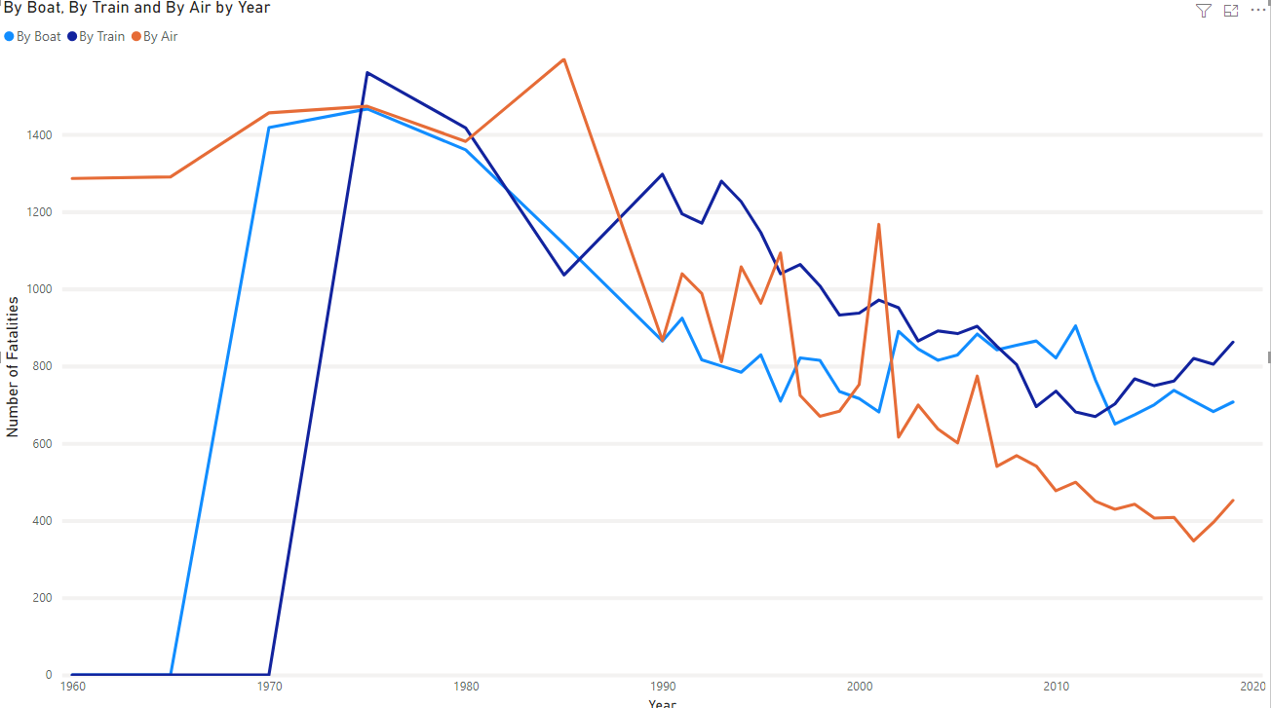

Slide 6
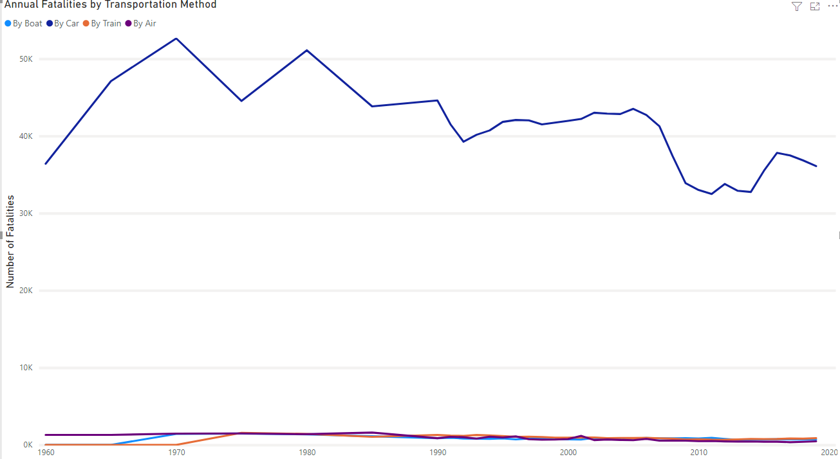

Slide 7
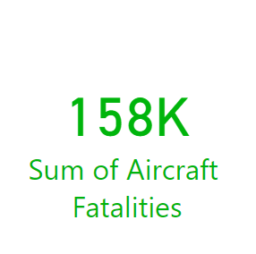
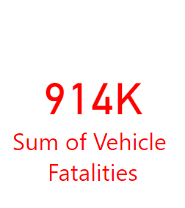

Slide 8
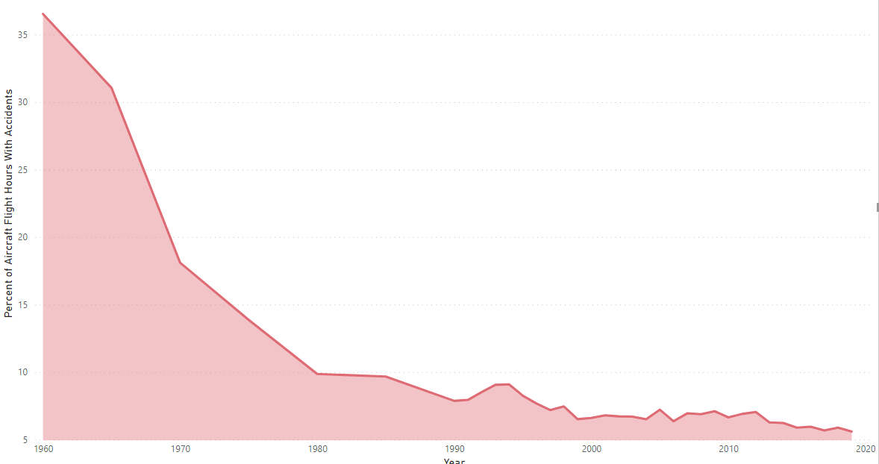

Slide 9
Resources
“Death Rate per Year | Bureau of Aircraft Accidents Archives.” Bureau of Aircraft Accidents Archives, 1990,www.baaa-acro.com/statistics/death-rate-per-year.Fivethirtyeight.
“Data/Airline-Safety at Master · Fivethirtyeight/Data.” GitHub, 2014,github.com/fivethirtyeight/data/tree/master/airline-safety.National Highway Traffic Safety Administration.
“FARS Encyclopedia.” National Highway Traffic SafetyAdministration, 2019, www-fars.nhtsa.dot.gov/Main/index.aspx
Qualman, Darrin. “Too Much Tourism: Global Air Travel and Climate Change ».” Darrin Qualman, 4 Oct. 2017, www.darrinqualman.com/global-air-travel-climate-change.
“Transportation Fatalities by Mode.” Bureau of Transportation Statistics, 2021, www.bts.gov/content/transportation-fatalities-mode.
“U.S. General Aviation Safety Data.” Bureau of Transportation Statistics, 2021, www.bts.gov/content/us-general-aviationa-safety-data.

Slide 10
Github
https://github.com/jrickord/DataPresentationVisualization

